Slide 1
Chapter 14: Kinetics
Dr. Aimée Tomlinson
Chem
1212

Slide 2
Section 14.1
Factors that Affect Reaction Rates

Slide 3
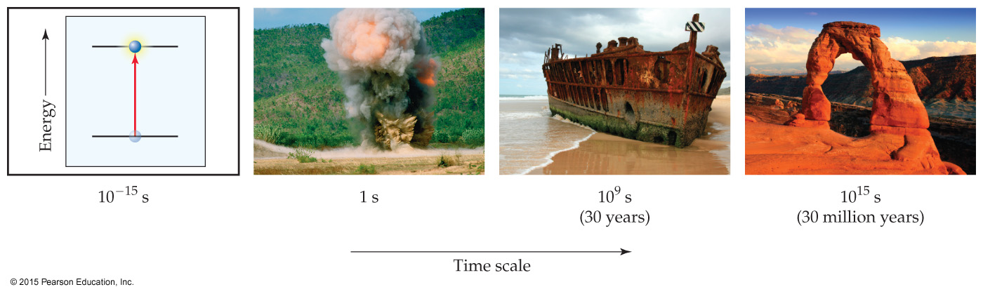
Chemical Kinetics
The speed at which a reaction occurs
Kinetics will also explain from a molecular-level how products are formed

Slide 4

Reaction Rate Factors
Physical state of the reactants
  More rapidly the reactants collide the more quickly they can react
  Homogeneous reactions are often faster
Reactant concentrations
  Increasing reactant concentration generally increase the rxn rate
  This occurs as there are more molecules so more collisions occur
Reaction temperature
  Reaction rates generally increase with T
  As T is increased molecules move faster allowing for more collisions
Presence of a catalyst – see 14.6
  Allow the reaction to go faster without impacting the balanced chemical equation

Slide 5
Section 14.2
Reaction Rates

Slide 6
Reaction Rate
The rates at which products are formed and reactants are consumed are connected
They are always represented as concentration change / time change
For the general case aA + bB → cC + dD the relationships are:
where Δt = t_{f} - t_{i}, [A] is the concentration of A (moles/L) and
Δ[A] = [A]_{f} - [A]_{i}
we loose reactants as products are formed which is why the rates of A & B are negative

Slide 7
Example Application of Definition
1. What is the rate relationship between the production of O₂ and O₃?
2O_{3(g)} → 3O_{2(g)}
the rate of O₂ production is 1.5 times faster than the ate of consumption of O₃
the rate of O₃ consumption is 2/3 times the production of O₂
2. The decomposition of N₂O₅ proceeds according to the equation:
2N₂O_{5(g)} → 4NO_{2(g)} + O_{2(g)}
If the rate of decomposition of N₂O₅ at a particular instant is 4.2 x 10⁻⁷ M/s, what is the rate of production of NO₂ and O₂?

Slide 8
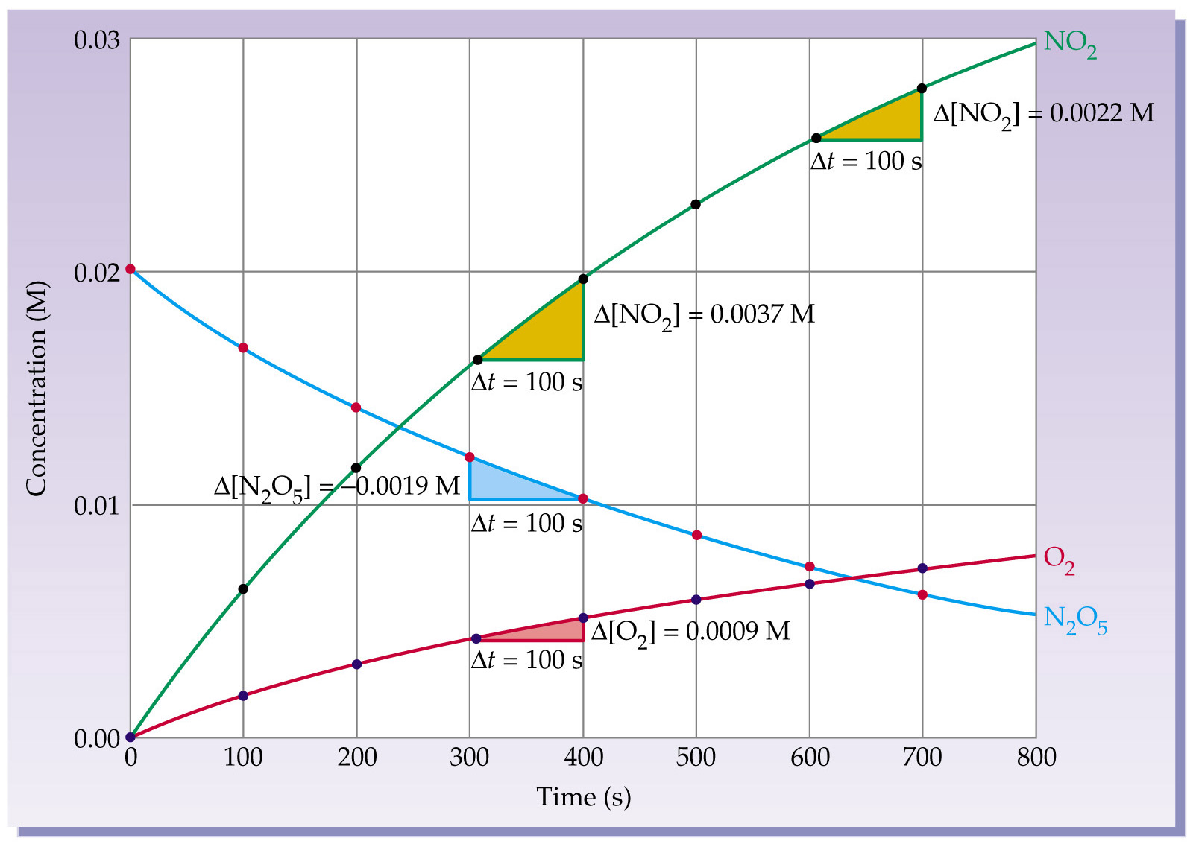
Example:

Slide 9
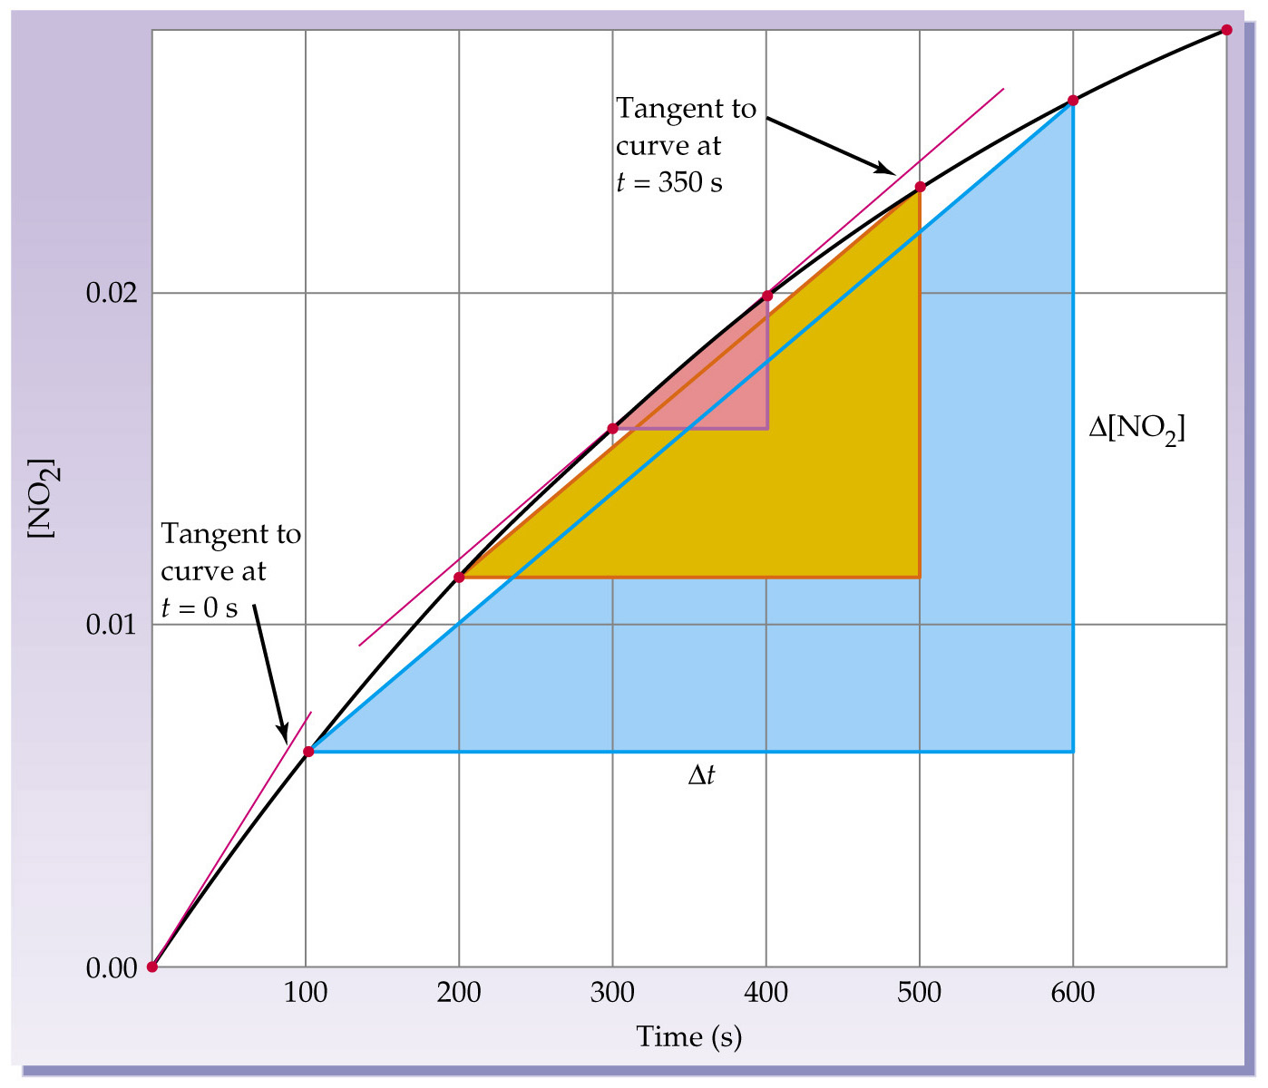
Different Types of Rates
Average Rate
Concentration change over a time interval (colored region in plot)
Instantaneous Rate
Slope of the tangent line at a given time (purple line in plot)
X 2

Slide 10
Section 14.3
Concentration
& Rate Laws

Slide 11
Rate Law
Relates the rate directly to reactant concentrations
For the General case aA + bB → cC + dD, the rate law is:
Rate = k[A]^{m}[B]^{n}
where m and n are determined experimentally
k is called the rate constant
CAUTION!!! Rate law is NOT related to stoichiometry!

Slide 12
Reaction Order
The power to which each reactant is raised
For the General case aA + bB → cC + dD, with
Rate = k[A]^{m}[B]^{n}
“m” is the order of reactant A and “n” is the order of reactant B
Overall reaction order is the sum of all or m+n in this case
Name the reactant orders and overall reaction order for
It is 1st order in CHCl₃ and ½ order for Cl₂ with 1 ½
order overall

Slide 13
Experimental Determination
of Rate Law

Slide 14
Illustrative Example
Determine the rate law, the rate constant and the reaction orders for
each reactant and the overall reaction order using the data given below.
Experiment | [A]₀ | [B]₀ | Initial Rate M/s
1 | 0.100 | 0.100 | 4.0 x 10⁻⁵
2 | 0.100 | 0.200 | 4.0 x 10⁻⁵
3 | 0.200 | 0.100 | 16.0 x 10⁻⁵

Slide 15
Rate constant k & Overall Order
k is an indicator of the overall rate order of the equation

Slide 16
Final Thoughts
What to do when finding ‘m’ isn’t obvious
X 4

Slide 17
Section 14.4
The Change of
Concentration with Time

Slide 18
First-Order Reactions

Slide 19
First-Order Integrated Rate Law
Final equation is the integrated rate law
Change in reactant concentration over time may be plotted to get the rate law
We plot ln[A] versus t:different phase from reactants
Only one plot will give a true linear fit!
Using fit equation we get the rate law:
rate = 8 x 10⁻⁴ s⁻¹[A]

Slide 20
Half-Life for First-Order Reaction

Slide 21
Second-Order Reactions

Slide 22
Second-Order Integrated Rate Law
Final equation is the integrated rate law
This time we plot 1/[A]t versus t to get linearity
Using fit equation we get the rate law:
rate = 8 x 10⁶ M⁻¹s⁻¹[A]²

Slide 23
ZerothOrder Reactions

Slide 24
Zeroth-Order Integrated Rate Law

Slide 25
Summary of Integrated Equations
X 5

Slide 26
Section 14.5
Temperature & Rate

Slide 27
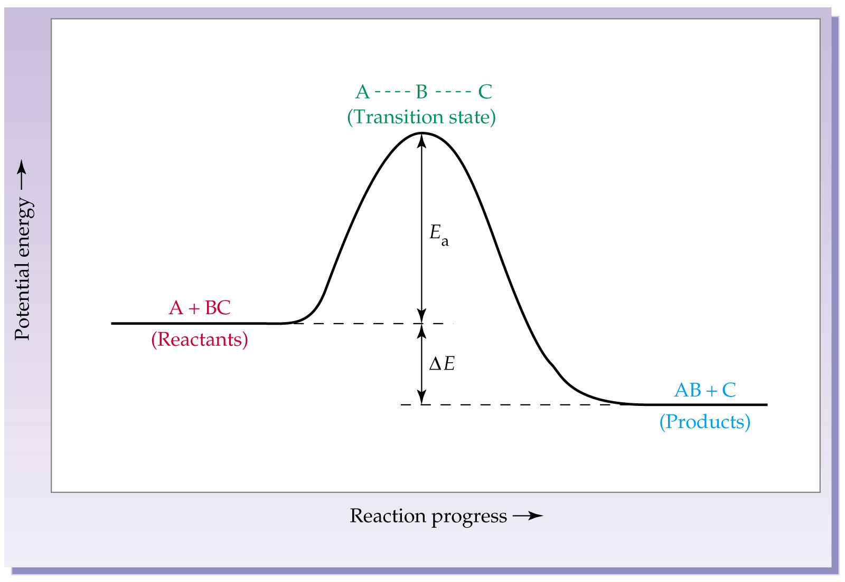
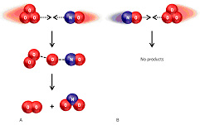
Arrhenius Equation
Relates rate to energy and temperature
Frequency Factor A
Energy of Activation, E_{a}
Indicative of the number of successful collisions
Energy that must be overcome to form products

Slide 28
Finding the E_{a} through plotting

Slide 29
Section 14.6
Reaction Mechanisms

Slide 30
Definitions
Reaction Mechanisms: how electrons move during a reaction
Intermediate
  Species that is produced then consumed
  Never partakes or appears in the rate law
Elementary Step
  A step that occurs in a reaction
  Most reactions have multiple elementary steps
  The stoichiometry of these steps CAN be used to get the reaction order
  The sum of these steps leads to the overall reaction
Molecularity
  Number of reacting particles in an elementary step
  Uni- (1 species), Bi- (2 species), Ter- (3 species)

Slide 31
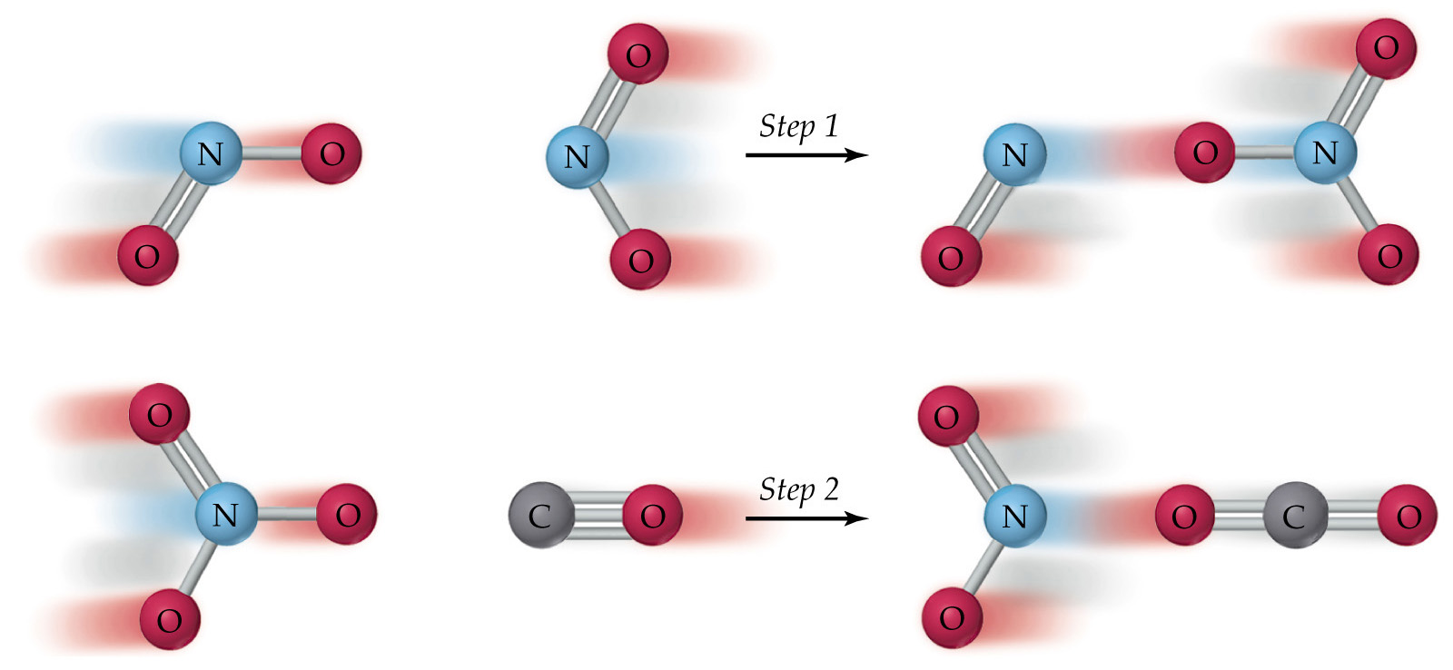
Example Application
  Given the mechanism below state the overall reaction, rate law and molecularity of each step as well as the intermediate.
  Rate law for step 1: rate₁ = k₁[NO₂]²
  Rate law for step 2: rate₂ = k₂[NO₃][CO]
  Both steps have 2 interacting species so bimolecular
  Intermediate is NO₃ which is produced then consumed

Slide 32
Rate Laws &
Reaction Mechanisms

Slide 33
Examples of Molecularity
Molecularity | Elementary step | Rate Law
Unimolecular | A → products | Rate = k[A]
Bimolecular | A + A → products | Rate = k[A]²
Bimolecular | A + B → products | Rate = [A][B]
Termolecular | A + A + A → products | Rate = k[A]³
Termolecular | A + A + B → products | Rate = k[A]²[B]
Termolecular | A + B + C → products | Rate = k[A][B][C]

Slide 34
Rate Laws for
Overall Reactions

Slide 35
Rate Determining Step
The slowest step in a mechanism
Just like the slowest person in a relay race – the slowest step in the mechanism will ruin the speed/time of the reaction
If the slow step is first it is very easy to get the rate law:

Slide 36
Example for Fast Step First
What is the rate law for the mechanism below?

Slide 37
Fast Equilibrium Applied Example
The rate laws for the thermal and photochemical decomposition of NO₂ are different. Which of the following mechanisms are possible for thermal and photochemical rates given the information below?
Thermal rate = k[NO₂]²
Photochemical rate = k[NO₂]

Slide 38
Mechanisms & Energy Profiles
The slow step has the larger Ea since it takes longer to generate more energy

Slide 39
Transition State
Defn: state at which reactant bonds are broken and product bonds begin to form
Located at the top of the hump for each elementary step in the reaction profile

Slide 40
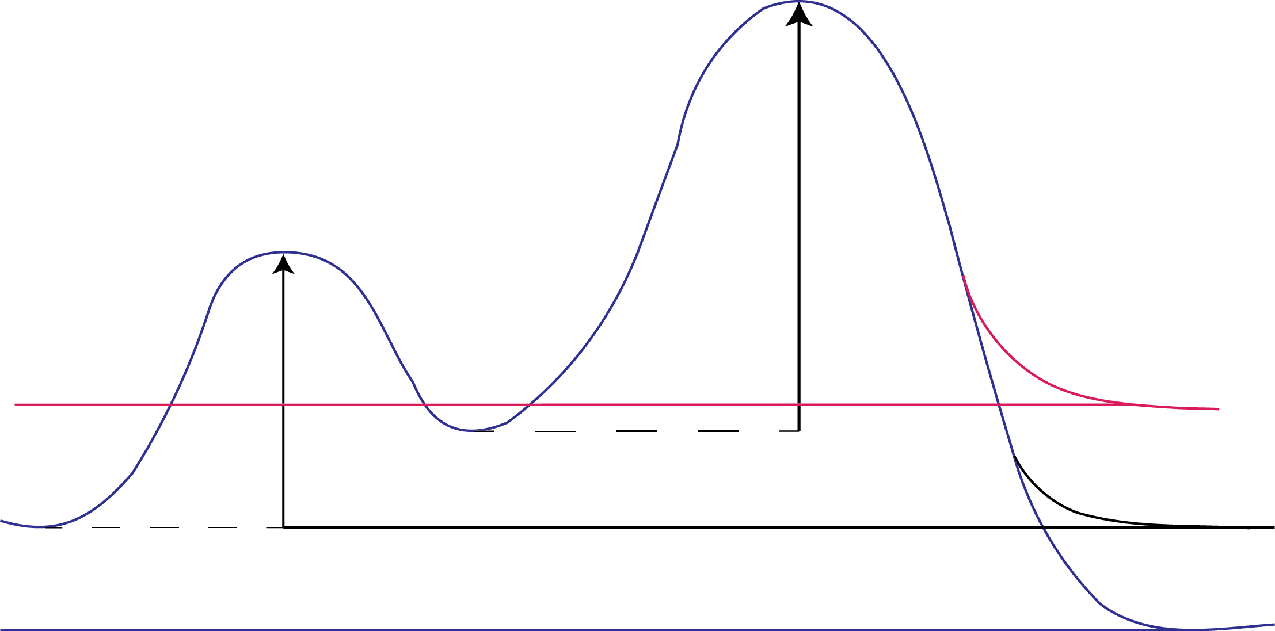
Reaction Profile
Draw each step as a hump – be sure the fast step hump is smaller than slow (measured from previous valley to peak max
Put the reactants and products in each valley
Located at the top of the hump for each elementary step in the reaction profile
Finally verify the end of the profile is indicative of endothermic, exothermic or neither
T.S.₂
_{A—C--D--E}
T.S.₁
_{A—B--C}
E_{a2}
E_{a1}
C + A
3A + B
ΔH_{rxn} > 0
endothermic
ΔH_{rxn} = 0
neither
D + E
ΔH_{rxn <} 0
exothermic
X5

Slide 41
Section 14.7
Catalysis

Slide 42
Catalyst
A species that lowers the activation energy of a chemical reaction and does not undergo any permanent chemical change
it is not present in the overall reaction expression
it is not present in the rate law
it must be consumed and produced in the elementary steps
Two types of catalysts:
  Homogeneous: in the same phase as the reactants
  Heterogeneous: a different phase from reactants

Slide 43
Example of Catalysis
Uncatalyzed mechanism - blue line in the figure
Cl Catalyzed mechanism - red line
X 2

